Slide 1
Changing the trajectory of drug R&D
Robert Plenge, MD, PhD
ASBMR
September 15, 2016

Slide 2
Our two fundamental challenges
Cost to develop an asset has increased by 1/3rd since 2010
Average peak sales per asset has halved since 2010

Slide 3
Where things go wrong & what that costs
$$$
But critical phase is choice of target and early development
About 1 out of 10 programs make it to Phase III
Paul et al NRDD 2010

Slide 4
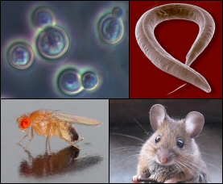

We relied on preclinical models to pick targets and estimate efficacy in heterogeneous human populations
It was…
Discovery
(new targets)
Optimization
(pre-clinical)
Early Development

Slide 5

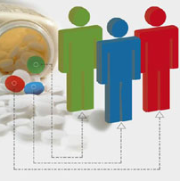
Today, humans are the model organism of choice for new targets and precision medicine
Discovery
(new targets)
Optimization
(pre-clinical)
Early Development

Slide 6
Science Translational Medicine, July 27, 2016

Slide 7
First, an example from cardiovascular disease

Slide 8
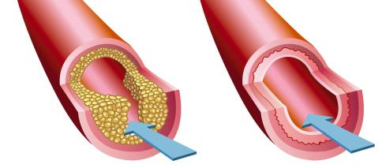
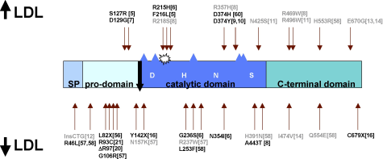
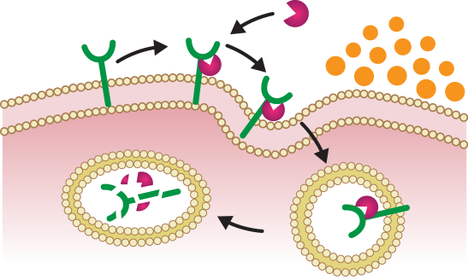
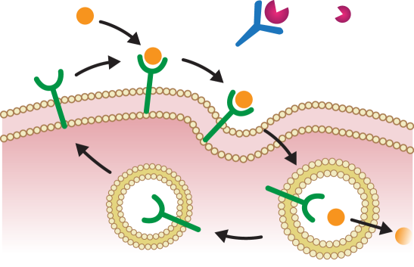


There are examples of human genetics leading to new drug targets (PCSK9)
Many genes influence cholesterol levels and risk of heart disease
PCSK9 mutations associated with high and low LDL cholesterol levels (and heart disease risk)
Atherosclerotic
Plaque
Blood Flow
…and design studies to find drugs that fix the underlying molecular defects – for example, blocking PCSK9 lowers LDL (or “bad”) cholesterol in the blood.
PCSK9
LDLR
LDL-C
mAb
LDLR
Recycling
Lysosome

Slide 9
Now, examples from osteoporosis and fracture risk

Slide 10
A quick primer on genetics of osteoporosis and related traits
>100 common variants associated with osteoporosis
Additional genes mutated in rare forms of bone mass loss / accrual
Experimental studies determine function, including gain- vs loss-of-function of risk allele
While many genes implicated, only a few have led to novel therapies…and those occur at the intersection of multiple alleles & function
David Karasik et al NRR 2016

Slide 11
FUNCTIONAL
STUDIES
MONOGENIC
TRAITS
Teriparatide
recombinant PTH
approved
Romosozumab
anti-sclerostin
phase III
Denosumab
anti-RANKL
approved
GENOME-WIDE ASSOCIATION STUDIES (GWAS)

Slide 12
Teriparatide
recombinant PTH
approved
Romosozumab
anti-sclerostin
phase III
osteoblast
Denosumab
anti-RANKL
approved
Estrada et al NG 2012

Slide 13
Pick a human phenotype for drug efficacy
High
Human Phenotype
Low
GOF
LOF
Gene function

Slide 14
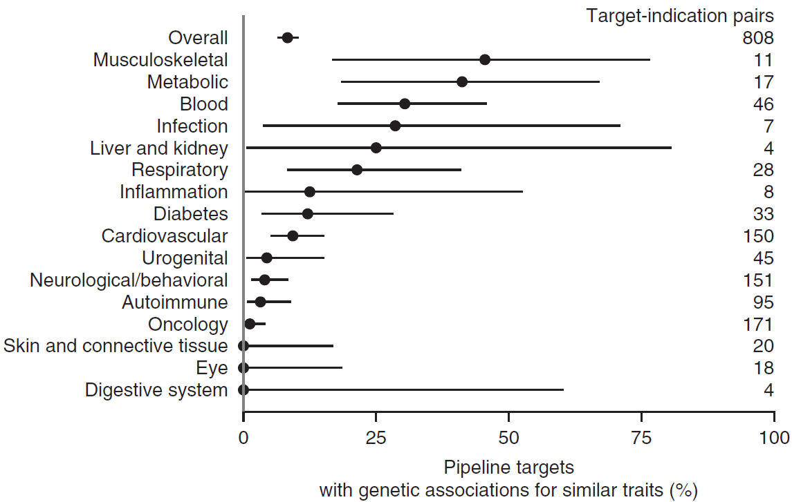
Pick a human phenotype for drug efficacy
High
Human Phenotype
Low
GOF
LOF
Gene function
Nelson et al NG 2015

Slide 15
Pick a human phenotype for drug efficacy
X
High
X
Identify a series of alleles with range of effect sizes in humans (but of unknown function)
X
Human Phenotype
X
X
X
X
Low
GOF
LOF
Gene function

Slide 16
Pick a human phenotype for drug efficacy
Efficacy
X
High
X
Assess biological function of alleles to estimate “efficacy” response curve
X
Human Phenotype
X
X
X
X
Low
GOF
LOF
Gene function

Slide 17
New target for
drug screen!
Pick a human phenotype for drug efficacy
Efficacy
X
X
Toxicity
High
Assess biological function of alleles to estimate “efficacy” response curve
X
Assess pleiotropy as proxy for ADEs
Human Phenotype
X
X
X
This provides evidence for the therapeutic window at the time of target ID & validation.
X
Low
GOF
LOF
Gene function

Slide 18
RANK-RANKL and denosumab
Pick a human phenotype for drug efficacy
Rare variants & osteopetrosis
Efficacy
Common variants & BMD, fracture risk
X
X
Toxicity
High bone
density
X
Assess pleiotropy as proxy for ADEs
Osteoporosis
X
X
X
This provides evidence for the therapeutic window at the time of target ID & validation.
Low bone
density
X
GOF
LOF
Rare RANK variants & Paget’s disease (no known GoF mutations in RANKL)
Gene function

Slide 19
RANK-RANKL and denosumab
Pick a human phenotype for drug efficacy
Rare variants & osteopetrosis
Efficacy
Common variants & BMD fracture risk
X
X
Toxicity
High bone
density
X
No “obvious” pleiotropic effects that could be ADEs
Osteoporosis
X
X
X
This provides evidence for the therapeutic window at the time of target ID & validation.
Low bone
density
X
GOF
LOF
Rare RANK variants & Paget’s disease (no known GoF mutations in RANKL)
Gene function

Slide 20
Clinical development of denosumab
Therapeutic modulation
  mAb mimics human mutation
Biomarkers of bone turnover
  Urinary& serum NTX
  Serum bone-specific alkaline phosphatase
Small (n=49) clinical PoB experiment
  Primary outcome change in bone turnover markers
Large (n=7,808) RCT for fracture risk reduction
  Reduced risk of new vertebral fracture by 68% vs. placebo (P < 0.001)
Goessl et al Ann. N.Y. Acad. Sci. 2012

Slide 21
But (and there is always a but…)

Slide 22
Limitations of the approach
Not all successful drugs will have genetic support
  Other approaches to causal human biology & drug discovery
Even those targets with genetic support may fail in clinical development
  Cathepsin K (CTSK) mutations cause pycnodysostosis
  Odanacatib failed in Phase III due to safety

Slide 23
Introducing novel therapies is an important component of our future health care system…
…but we need to do more to deliver affordable medicines that matter

Slide 24
Questions?
@rplenge

