Slide 1
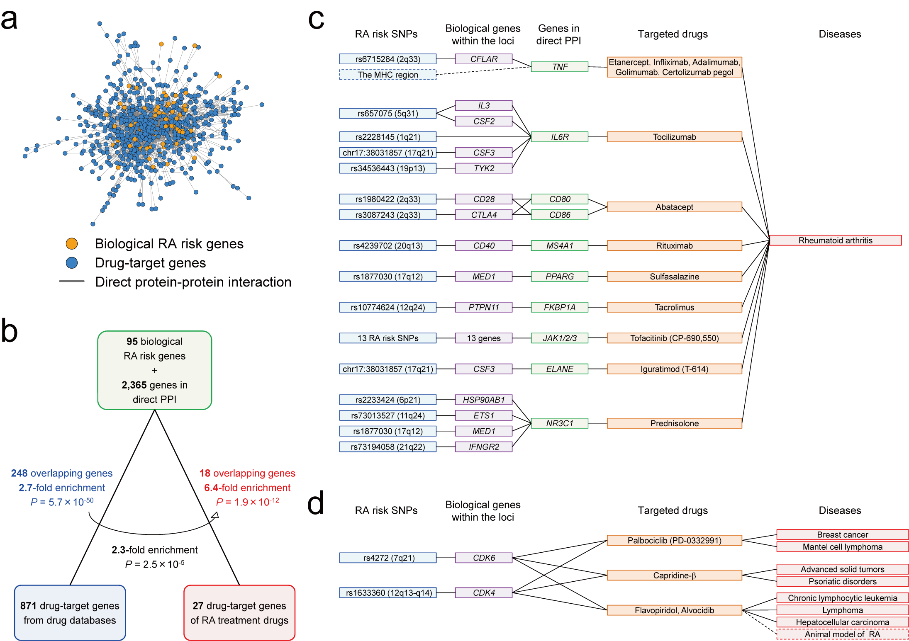
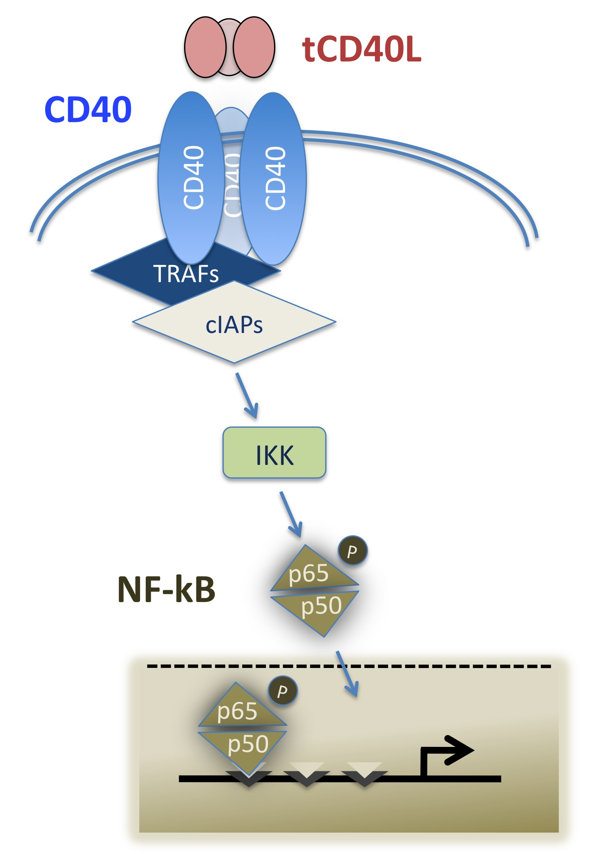
Select relevant phenotypes for drug efficacy
Diverse approaches (from GWAS to sequencing) to Identify a series of alleles associated with trait of interest (from common to rare)
Experimentally validate function of alleles, genes and pathway for (a) effect size, (b) MOA, and (c) assays for target engagement
Test same alleles for association to other traits that may be considered “adverse events”
one gene,
one target
LOF
GOF
Association with trait of interest
Start with human data that can differentiate cause from consequence (e.g., human genetics, longitudinal clinical data, therapeutic interventions)
Integrate diverse ‘omics datasets to build robust biological pathways
Make the pathways actionable for drug discovery (e.g., new targets, phenotypic screens) – including experimental perturbation of pathways to recapitulate human genetic data
multiple genes,
pathways

Slide 2
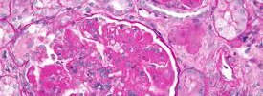
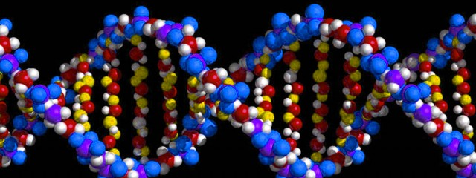
Human genetics, longitudinal clinical data, therapeutic perturbations
unmet clinical need
human data
Gene expression, protein-protein interactions, model organisms, etc.
biological pathways
Validate clinical phenotypes for drug discovery and assign SOC to genetic pathways
Assign targets to genetic pathways and assess differentiation from SOC
Identify new targets for drug discovery programs
Develop cellular and molecular assays to advance pathway-based screens
Make complex pathways actionable for drug discovery

