Slide 1
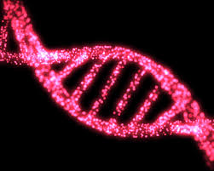
Model for immuno-oncology
Stage
Tumor
-genesis
Tumor mutations
Antigen presentation
Immune recognition
Immune silencing

Slide 2
Genomics to diagnose stages
How to Recognize
Stage
WGS
negative
Tumor
-genesis
RNA-seq
negative
TCR-seq
negative
Tumor mutations
Antigen presentation
WGS
positive
RNA-seq
positive
TCR-seq
positive
Immune recognition
Immune silencing

Slide 3
Genomic patterns are important for immunotherapy
How to Recognize
Stage
Mechanism and Tx Strategy
WGS
negative
Tumor
-genesis
Mech: ImmRx-independent
Rx: EpiGx or vaccine to induce response to immRx
RNA-seq
negative
Mech: ImmTx-resistant/refractory due to dysfunctional Ag presentation (AgPres)
Rx: EpiGx to upregulate AgPres
TCR-seq
negative
Tumor mutations
Antigen presentation
Mech: ImmTx-resistant/refract due to lack of imm infiltrate
Rx: Immune recruitment, NK
WGS
positive
RNA-seq
positive
TCR-seq
positive
Immune recognition
Mech: Spontaneous immune-dependent elimination of tumor
Rx: no therapy required
Immune silencing
Mech: Immune silencing
Rx: Tumor-immunoTx strategy (e.g., PD1)

