Slide 1


Biomarker development for targets with human genetic validation
Robert M. Plenge, MD, PhD
Vice President, Merck Research Laboratories (MRL)
Head, Genetics & Pharmacogenomics (GpGx)
1

Slide 2
Target ID and validation
Lead optimization
Phase I-III Clinical Trials
Weak human validation
MOA for initial screen and hit package
pre-clinical models of PK/PD, efficacy and safety
indication selection and patient stratification
elevated TNF levels in sepsis, rheumatoid arthritis, other inflammatory conditions -> reduce circulating TNF
ensure that reducing TNF is safe and effective in animal models, with PK/PD biomarkers for target engagement
Test first in sepsis (failed), then in other inflammatory conditions such as RA (very successful)
Beutler (1985) Science
Keffer (1991) EMBO
Tracey (1987) Nature
Williams (1992) PNAS
Exley (1990) Lancet
Elliott (1994) Lancet

Slide 3
Target ID and validation
Lead optimization
Phase I-III Clinical Trials
Weak human validation
MOA for initial screen and hit package
pre-clinical models of PK/PD, efficacy and safety
indication selection and patient stratification
MOA based on genetics for initial screen and hit package
Strong human validation
pre-clinical models of PK/PD and safety
patient stratification

Slide 4
Target ID and validation
Lead optimization
Phase I-III Clinical Trials
MOA based on genetics for initial screen and hit package
Strong human validation
pre-clinical models of PK/PD and safety
patient stratification
LOF mutations lower circulating PCSK9, which lower LDL cholesterol and protect from CAD -> reduce circulating PCSK9
ensure that reducing PCSK9 is safe in animal models, with PK/PD markers that recapitulate human genetic findings
Test in patients with high cholesterol (subset by PCSK9 genotype), with trials enrolled to demonstrate reduced risk of CAD

Slide 5
2
Lowers LDL cholesterol
Protects against CAD
1
Notes:
slide 2: what is unique about genetics: prior to the onset; not an epiphenom -> if we can find alleles that influence risk, then this informs…and identifies the Achilles' heel of the pathway (which might represent targets of therapy)

Slide 6
3
2
Lowers LDL cholesterol
Protects against CAD
Loss-of-function mutations alter PCSK9 secretion
1
Notes:
slide 2: what is unique about genetics: prior to the onset; not an epiphenom -> if we can find alleles that influence risk, then this informs…and identifies the Achilles' heel of the pathway (which might represent targets of therapy)

Slide 7
4
2
Lowers LDL cholesterol
Protects against CAD
Loss-of-function mutations alter PCSK9 secretion
No obvious “ADE” phenotypes
1
Notes:
slide 2: what is unique about genetics: prior to the onset; not an epiphenom -> if we can find alleles that influence risk, then this informs…and identifies the Achilles' heel of the pathway (which might represent targets of therapy)

Slide 8
Human genetics is a unique tool to test therapeutic hypotheses
Human genetics is a unique tool to test therapeutic hypotheses
Nature’s perturbation of many drug targets
Links human physiology to a perturbation
Indicates gain- or loss-of-function
Provides MOA of desired perturbation
Provides allelic series for range of effects
Differentiates between cause/consequence
Enables “Mendelian randomization” experiments
There is a wealth of accumulating data
Notes:
slide 2: what is unique about genetics: prior to the onset; not an epiphenom -> if we can find alleles that influence risk, then this informs…and identifies the Achilles' heel of the pathway (which might represent targets of therapy)

Slide 9
What is the model for use of genetic data to guide drug discovery, including biomarker development?

Slide 10
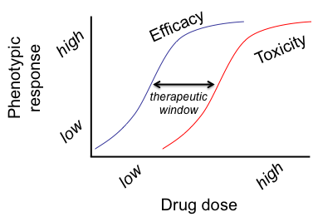
We determine dose-response in clinical trials, after many years and millions of dollars
Notes:
Differ a bit in what Joe Loscalzoe said last night, in that I think a mjaor reason … wrong models.

Slide 11
Biomarker development plan should leverage data at the time a genetic target is identified and validated
We aspire to determine dose-response at the time of target validation
Plenge, Scolnick & Altshuler (2013) Nat Rev Drug Discovery
Notes:
Differ a bit in what Joe Loscalzoe said last night, in that I think a mjaor reason … wrong models.

Slide 12
Pick a human phenotype for drug efficacy
Identify a series of alleles with range of effect sizes in humans (but of unknown function)
X
high
X
X
Human phenotype
X
X
X
low
X
GOF
LOF
Gene function
Notes:
GWAS, population-based sequencing and Mendelian sequencing will be important to identify a series of alleles with a range of effects on human phenotypes.
The “human phenotypes” can be related but not exact matches – for example, primary immunodeficiency and risk of RA.
Complete human “knock-outs” are very important, in order to understand the maximum effect of target perturbation over the lifetime of an individual.

Slide 13
Pick a human phenotype for drug efficacy
Identify a series of alleles
X
high
X
X
Efficacy
X
Human phenotype
X
X
X
low
X
Assess biological function of alleles to estimate “efficacy” response curve
GOF
LOF
Gene function
Notes:
1. Once alleles are identified, it is critical to estimate biological effect of gene function through direct experimentation.

Slide 14
Pick a human phenotype for drug efficacy
Assess pleiotropy as proxy for ADEs
Identify a series of alleles
X
high
X
X
Efficacy
X
X
Toxicity
Human phenotype
X
X
This provides evidence for the therapeutic window at the time of target ID & validation.
low
X
GOF
LOF
Gene function
Assess biological function of alleles
New target for drug screen!
Notes:
Pleiotropy should be assessed in longitudinal patient collections such as patients followed as part of routine health care (e.g., EMR cohorts) or more traditional longitudinal cohorts (e.g., Framingham, Dallas Heart Study).
There are advantages to cohorts ascertained based on specific phenotypes (e.g., heart disease), as well as those without specific ascertainment criteria (i.e., general population).

Slide 15
Not all genetic phenotypes are appropriate surrogates for drug efficacy
Need to consider underlying biology and therapeutic indication

Slide 16
Pick a human phenotype for drug efficacy
Notes:
GWAS, population-based sequencing and Mendelian sequencing will be important to identify a series of alleles with a range of effects on human phenotypes.
The “human phenotypes” can be related but not exact matches – for example, primary immunodeficiency and risk of RA.
Complete human “knock-outs” are very important, in order to understand the maximum effect of target perturbation over the lifetime of an individual.

Slide 17
Pathways that lead to RA are related to pathways in active disease
Genetics of susceptibility
?????
Drugs treat active disease
Klareskog et al Lancet 2009

Slide 18
Multi-ethnic GWAS of RA risk
>30,000 RA cases and 70,000 matched controls (Asian, European ancestry)
42 new loci at P<5x10⁻⁸, bringing the total to >100 RA risk loci
Trans-ethnic mapping for causal alleles
Integrate with other genomic data to understand biological pathways
Integrate with drug databases to test – overlap with known RA drugs?
Okada et al (2014) Nature
Notes:
slide 2: what is unique about genetics: prior to the onset; not an epiphenom -> if we can find alleles that influence risk, then this informs…and identifies the Achilles' heel of the pathway (which might represent targets of therapy)

Slide 19
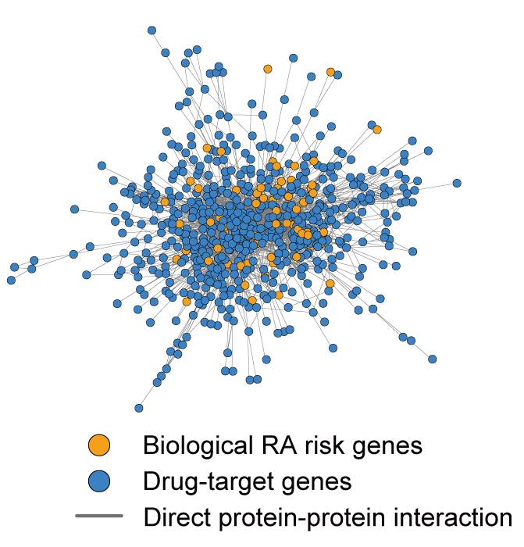
Enrichment between RA genetic networks and RA drugs
Phenotype of “RA susceptibility” is an appropriate surrogate phenotype for “drug efficacy”
Notes:
slide 2: what is unique about genetics: prior to the onset; not an epiphenom -> if we can find alleles that influence risk, then this informs…and identifies the Achilles' heel of the pathway (which might represent targets of therapy)

Slide 20
There are specific examples of drug-gene pairs that reinforce that “RA susceptibility” is an appropriate surrogate for “drug efficacy”
IL6R – tocilizumab
CTLA4 – abatacept

Slide 21
Identify a series of alleles with range of effect sizes
Notes:
GWAS, population-based sequencing and Mendelian sequencing will be important to identify a series of alleles with a range of effects on human phenotypes.
The “human phenotypes” can be related but not exact matches – for example, primary immunodeficiency and risk of RA.
Complete human “knock-outs” are very important, in order to understand the maximum effect of target perturbation over the lifetime of an individual.

Slide 22
A few principles on genetic studies
Extremely large sample sizes (tens of thousands…or more!) are required to associate alleles with traits
GWAS powerful at identifying known polymorphisms (low-frequency or common), but sequencing is required for unknown variants (rare or private mutations)
Most of these studies will occur as part of large, pre-competitive collaborations, e.g., Accelerating Medicines Partnership (AMP) sponsored by NIH and industry
There are a few examples today of genes with an allelic series…PCSK9, Nav1.7, LRKK2, SLC30A8 … and TYK2 … but population genetics predicts there will be more!
Notes:
Unpublished data in RA; similar results in SLE and IBD.
Functional studies are basic, but nonetheless confirm LOF of two of the alleles.
While rare, complete TYK2 knockouts exist in human families; phenotype is Hyper IgE Syndrome (HIES) and susceptibility to multiple infectious pathogens (viral infections, atypical mycobacteria, atopic dermatitis)
A study of ~25,000 patients with genetic data linked to EMR data indicate that there are no obvious phenotypes (other than protection from RA, autoimmunity) associated with the LOF protective alleles, suggesting that drugs that inhibit TYK2 to partial levels will be well-tolerated in the general population.

Slide 23
Example of TYK2 and RA
Multiple alleles protect from RA
P=10⁻²⁵ in >30,000 case-control samples
Dorothee Diogo et al (unpublished)
Collaboration with Josh Denny (Vanderbilt), Zak Kohane (i2b2), Elaine Mardis (WashU), Tim Behrens (Genentech), Peter Gregersen and RACI…many others!
Notes:
Unpublished data in RA; similar results in SLE and IBD.
Functional studies are basic, but nonetheless confirm LOF of two of the alleles.
While rare, complete TYK2 knockouts exist in human families; phenotype is Hyper IgE Syndrome (HIES) and susceptibility to multiple infectious pathogens (viral infections, atypical mycobacteria, atopic dermatitis)
A study of ~25,000 patients with genetic data linked to EMR data indicate that there are no obvious phenotypes (other than protection from RA, autoimmunity) associated with the LOF protective alleles, suggesting that drugs that inhibit TYK2 to partial levels will be well-tolerated in the general population.

Slide 24
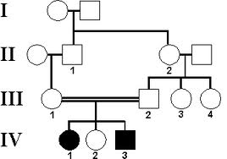
Complete knock-out leads to PID
Rare families with complete loss of TYK2
Indicates effect of maximum inhibition in ideal model organism (humans)
(Note: this pedigree is for illustrative purposes only)
Notes:
Unpublished data in RA; similar results in SLE and IBD.
Functional studies are basic, but nonetheless confirm LOF of two of the alleles.
While rare, complete TYK2 knockouts exist in human families; phenotype is Hyper IgE Syndrome (HIES) and susceptibility to multiple infectious pathogens (viral infections, atypical mycobacteria, atopic dermatitis)
A study of ~25,000 patients with genetic data linked to EMR data indicate that there are no obvious phenotypes (other than protection from RA, autoimmunity) associated with the LOF protective alleles, suggesting that drugs that inhibit TYK2 to partial levels will be well-tolerated in the general population.

Slide 25
Assess biological function to estimate “efficacy”
Notes:
GWAS, population-based sequencing and Mendelian sequencing will be important to identify a series of alleles with a range of effects on human phenotypes.
The “human phenotypes” can be related but not exact matches – for example, primary immunodeficiency and risk of RA.
Complete human “knock-outs” are very important, in order to understand the maximum effect of target perturbation over the lifetime of an individual.

Slide 26
TYK2 is a member of JAK-STAT signaling pathway
Cytokine
IFN
cytoplasm
TYK2 phosphorylation
JakA
Tyk2
pSTAT
pSTAT
pSTAT
pSTAT
nucleus
pSTAT
pSTAT
transcription
Notes:
Unpublished data in RA; similar results in SLE and IBD.
Functional studies are basic, but nonetheless confirm LOF of two of the alleles.
While rare, complete TYK2 knockouts exist in human families; phenotype is Hyper IgE Syndrome (HIES) and susceptibility to multiple infectious pathogens (viral infections, atypical mycobacteria, atopic dermatitis)
A study of ~25,000 patients with genetic data linked to EMR data indicate that there are no obvious phenotypes (other than protection from RA, autoimmunity) associated with the LOF protective alleles, suggesting that drugs that inhibit TYK2 to partial levels will be well-tolerated in the general population.

Slide 27
Functional studies show LOF
Studies in cell lines
Implicates catalytic function impaired
However, there are other functions of TYK2 which need further exploration
Li et al (2013) J Imm
Risk
Protective
Notes:
Unpublished data in RA; similar results in SLE and IBD.
Functional studies are basic, but nonetheless confirm LOF of two of the alleles.
While rare, complete TYK2 knockouts exist in human families; phenotype is Hyper IgE Syndrome (HIES) and susceptibility to multiple infectious pathogens (viral infections, atypical mycobacteria, atopic dermatitis)
A study of ~25,000 patients with genetic data linked to EMR data indicate that there are no obvious phenotypes (other than protection from RA, autoimmunity) associated with the LOF protective alleles, suggesting that drugs that inhibit TYK2 to partial levels will be well-tolerated in the general population.

Slide 28
KEY POINT
Assay for drug screen – and biomarker of target engagement – should reflect MOA of genetic perturbation

Slide 29
Assess pleiotropy as proxy for adverse events
Notes:
GWAS, population-based sequencing and Mendelian sequencing will be important to identify a series of alleles with a range of effects on human phenotypes.
The “human phenotypes” can be related but not exact matches – for example, primary immunodeficiency and risk of RA.
Complete human “knock-outs” are very important, in order to understand the maximum effect of target perturbation over the lifetime of an individual.

Slide 30
PheWAS identifies RA and autoimmunity, but not other ADE’s
RA surpasses study-wide significance (dotted line)
Notes:
Unpublished data in RA; similar results in SLE and IBD.
Functional studies are basic, but nonetheless confirm LOF of two of the alleles.
While rare, complete TYK2 knockouts exist in human families; phenotype is Hyper IgE Syndrome (HIES) and susceptibility to multiple infectious pathogens (viral infections, atypical mycobacteria, atopic dermatitis)
A study of ~25,000 patients with genetic data linked to EMR data indicate that there are no obvious phenotypes (other than protection from RA, autoimmunity) associated with the LOF protective alleles, suggesting that drugs that inhibit TYK2 to partial levels will be well-tolerated in the general population.

Slide 31
PheWAS identifies RA and autoimmunity, but not other ADE’s
No obvious risk of infection
Notes:
Unpublished data in RA; similar results in SLE and IBD.
Functional studies are basic, but nonetheless confirm LOF of two of the alleles.
While rare, complete TYK2 knockouts exist in human families; phenotype is Hyper IgE Syndrome (HIES) and susceptibility to multiple infectious pathogens (viral infections, atypical mycobacteria, atopic dermatitis)
A study of ~25,000 patients with genetic data linked to EMR data indicate that there are no obvious phenotypes (other than protection from RA, autoimmunity) associated with the LOF protective alleles, suggesting that drugs that inhibit TYK2 to partial levels will be well-tolerated in the general population.

Slide 32
PheWAS suggests that tofacitinib ADEs not related to TYK2 inhibition
Positive controls show association (i.e., PheWAS works!)
Notes:
Unpublished data in RA; similar results in SLE and IBD.
Functional studies are basic, but nonetheless confirm LOF of two of the alleles.
While rare, complete TYK2 knockouts exist in human families; phenotype is Hyper IgE Syndrome (HIES) and susceptibility to multiple infectious pathogens (viral infections, atypical mycobacteria, atopic dermatitis)
A study of ~25,000 patients with genetic data linked to EMR data indicate that there are no obvious phenotypes (other than protection from RA, autoimmunity) associated with the LOF protective alleles, suggesting that drugs that inhibit TYK2 to partial levels will be well-tolerated in the general population.

Slide 33
PheWAS suggests that tofacitinib ADEs not related to TYK2 inhibition
No obvious association with LDL levels or WBC (caution: power)
Notes:
Unpublished data in RA; similar results in SLE and IBD.
Functional studies are basic, but nonetheless confirm LOF of two of the alleles.
While rare, complete TYK2 knockouts exist in human families; phenotype is Hyper IgE Syndrome (HIES) and susceptibility to multiple infectious pathogens (viral infections, atypical mycobacteria, atopic dermatitis)
A study of ~25,000 patients with genetic data linked to EMR data indicate that there are no obvious phenotypes (other than protection from RA, autoimmunity) associated with the LOF protective alleles, suggesting that drugs that inhibit TYK2 to partial levels will be well-tolerated in the general population.

Slide 34
Putting it all together for TYK2…
Multiple alleles protect from RA
Functional studies show LOF
P=10⁻²⁵ in >30,000 case-control samples
Complete KO leads to PID
No obvious “ADEs” in ~30K EMR patients
Notes:
Unpublished data in RA; similar results in SLE and IBD.
Functional studies are basic, but nonetheless confirm LOF of two of the alleles.
While rare, complete TYK2 knockouts exist in human families; phenotype is Hyper IgE Syndrome (HIES) and susceptibility to multiple infectious pathogens (viral infections, atypical mycobacteria, atopic dermatitis)
A study of ~25,000 patients with genetic data linked to EMR data indicate that there are no obvious phenotypes (other than protection from RA, autoimmunity) associated with the LOF protective alleles, suggesting that drugs that inhibit TYK2 to partial levels will be well-tolerated in the general population.

Slide 35
Efficacy
Toxicity
high
1
TYK2 -/- (protection)
2
Δ-TYK2 homozygotes (immunodeficiency)
Immune phenotype
TYK2 +/- (protection)
Human genetics also guides biomarker development based on functional data in ideal model organism – humans!
3
low
normal
LOF
TYK2 function
Thus, (1) complete LOF leads to immunodeficiency;
(2) partial LOF (+/- heterozygotes) protects from RA; and
(3) -/- homozygotes have greatest protection from RA without obvious evidence of infection or other ADEs.
Notes:
slide 2: what is unique about genetics: prior to the onset; not an epiphenom -> if we can find alleles that influence risk, then this informs…and identifies the Achilles' heel of the pathway (which might represent targets of therapy)

Slide 36
Finally, can genetics be used to select alternative indications for “repurposing”?

Slide 37
Same alleles associated with SLE – suggests other indications
P=10⁻¹⁸ in ~15,000 case-control samples
Notes:
Unpublished data in RA; similar results in SLE and IBD.
Functional studies are basic, but nonetheless confirm LOF of two of the alleles.
While rare, complete TYK2 knockouts exist in human families; phenotype is Hyper IgE Syndrome (HIES) and susceptibility to multiple infectious pathogens (viral infections, atypical mycobacteria, atopic dermatitis)
A study of ~25,000 patients with genetic data linked to EMR data indicate that there are no obvious phenotypes (other than protection from RA, autoimmunity) associated with the LOF protective alleles, suggesting that drugs that inhibit TYK2 to partial levels will be well-tolerated in the general population.

Slide 38
Summary
Phenotype matters!
  overlap with approved drugs helps to validate phenotype
An allelic series is a starting point
  provides a range of genetic perturbations
Functional studies define MOA
  provides direction for assays and biomarkers
Pleiotropy estimates potential ADEs
  PheWAS is a novel strategy in humans
Pleiotropy also helps with repurposing
  for TYK2, genetics point to RA and SLE
Notes:
Unpublished data in RA; similar results in SLE and IBD.
Functional studies are basic, but nonetheless confirm LOF of two of the alleles.
While rare, complete TYK2 knockouts exist in human families; phenotype is Hyper IgE Syndrome (HIES) and susceptibility to multiple infectious pathogens (viral infections, atypical mycobacteria, atopic dermatitis)
A study of ~25,000 patients with genetic data linked to EMR data indicate that there are no obvious phenotypes (other than protection from RA, autoimmunity) associated with the LOF protective alleles, suggesting that drugs that inhibit TYK2 to partial levels will be well-tolerated in the general population.

Slide 39
Back-ups
Notes:
Unpublished data in RA; similar results in SLE and IBD.
Functional studies are basic, but nonetheless confirm LOF of two of the alleles.
While rare, complete TYK2 knockouts exist in human families; phenotype is Hyper IgE Syndrome (HIES) and susceptibility to multiple infectious pathogens (viral infections, atypical mycobacteria, atopic dermatitis)
A study of ~25,000 patients with genetic data linked to EMR data indicate that there are no obvious phenotypes (other than protection from RA, autoimmunity) associated with the LOF protective alleles, suggesting that drugs that inhibit TYK2 to partial levels will be well-tolerated in the general population.

Slide 40
IL6R polymorphism influences amount of soluble IL6R …
IL6R Asp358Ala variant
proteolytic cleavage
Asp = more membrane
Ala = more soluble

Slide 41
…and the IL6R polymorphism decreases circulating CRP levels
P=9.9x10⁻⁵²
IL6RMR Consortium (2012) Lancet
Asp/Asp
Asp/Ala
Ala/Ala
CRP

Slide 42
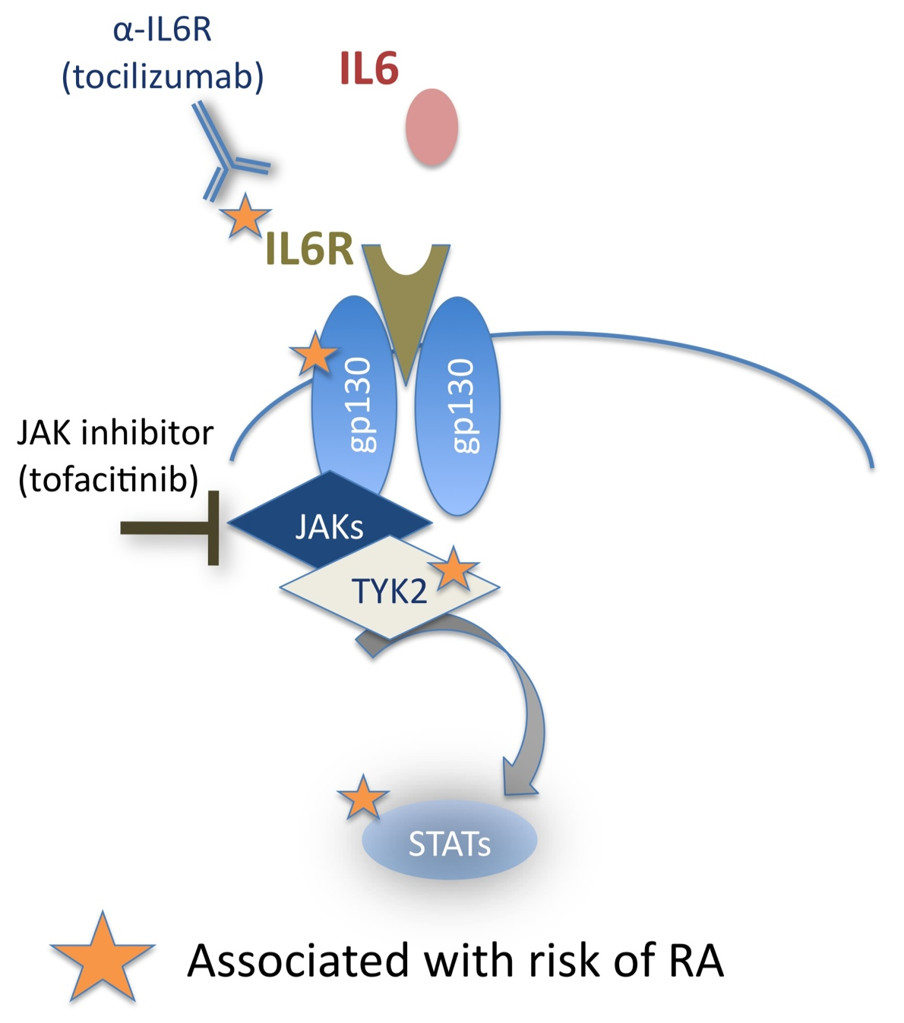
“RA susceptibility” is an appropriate phenotype for “drug efficacy”
IL6R genetics
More soluble IL6R
Reduced CRP
Protection against RA

