Slide 1

The Role of Human Genetics in Drug Discovery
Robert Plenge, MD, PhD

Slide 2
Why do drugs fails?

Slide 3
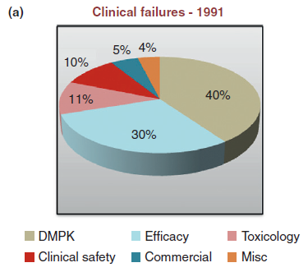
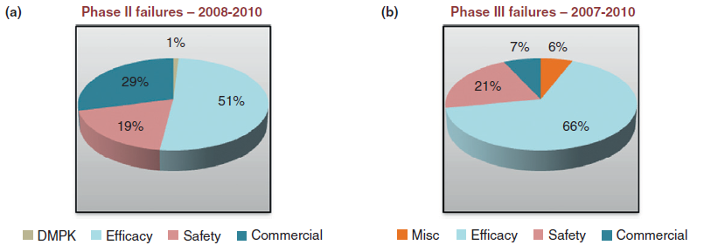
It was pharmacokinetics…
…now it is efficacy/safety.

Slide 4
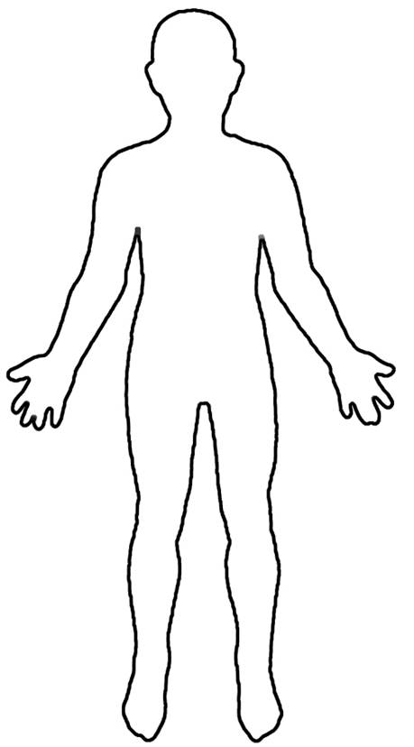



Human genetics helps to identify potential drug targets to start drug discovery
“Drug”
But, tens of thousands of potential targets…
“Target”
?
…and which one causes disease?
…and how do you perturb the target?
Disease
Healthy
The key steps are:
Map genetic differences in those with disease vs healthy;
Understand how these genetic differences lead to disease;
Develop drugs against these targets that reverse disease processes in the population.
“Drug”
vs
Disease
Healthy

Slide 5
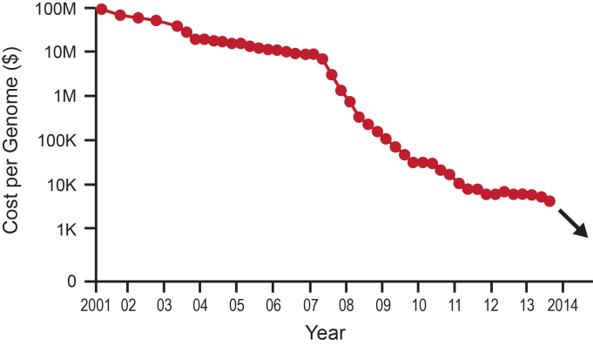
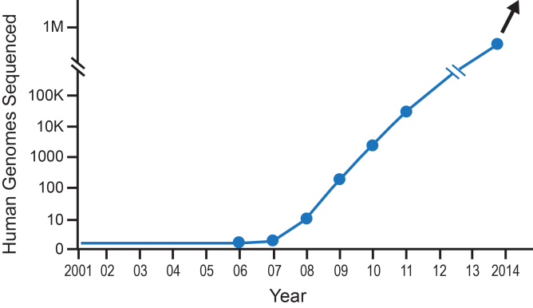
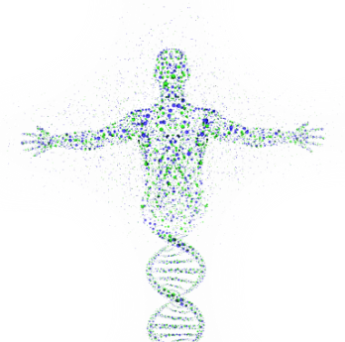
Until recently, it was very difficult to establish accurate genetic maps of human disease… now we can!
Cost of genome sequencing continues to drop rapidly…
…which results in many more human genomes being sequenced…
…and a more accurate molecular understanding of human disease.

Slide 6
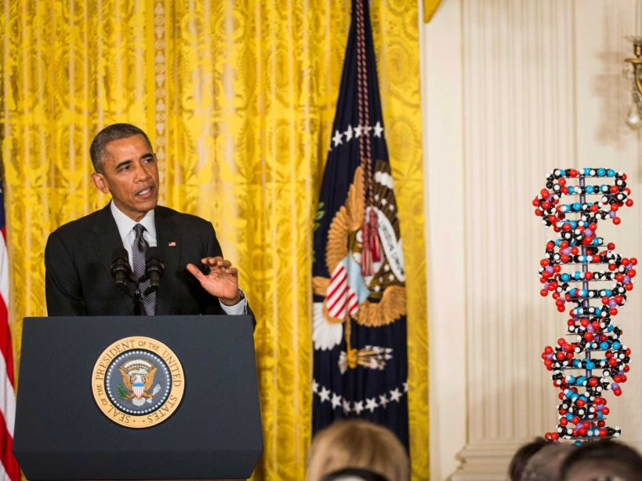

Slide 7
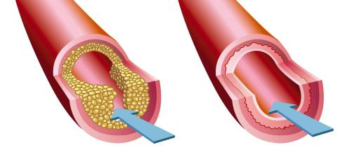
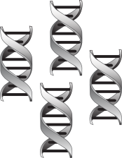
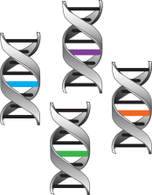
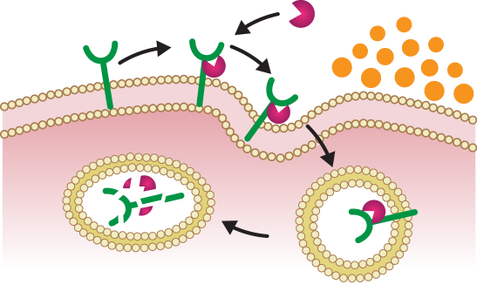
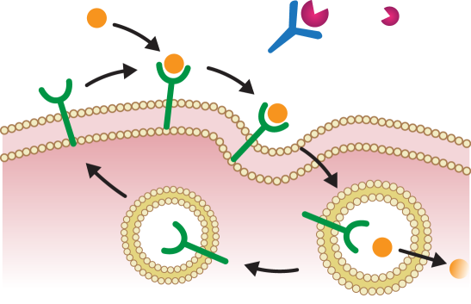


There are encouraging examples of this principle working in drug discovery – example of PCSK9
Many genes influence cholesterol levels and risk of heart disease
Thanks to new technologies, we can now find these disease genes…
Atherosclerotic
Plaque
Disease
Healthy
Blood Flow
…and design studies to find drugs that fix the underlying molecular defects – for example, blocking PCSK9 lowers LDL (or “bad”) cholesterol in the blood.
PCSK9
LDLR
LDL-C
mAb
LDLR
Recycling
Lysosome

Slide 8
Also evidence that a portfolio of projects based on human genetics will outperform other portfolios

Slide 9
What is the strategy?

Slide 10
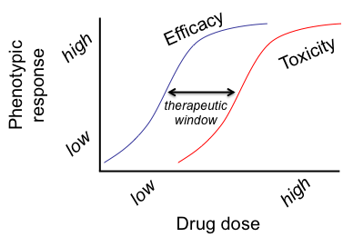
TIDVAL
Lead Optimization
First-in-human Trials
Phase II-III Clinical Trials
We determine dose-response in clinical trials, after many years and millions of dollars

Slide 11
TIDVAL
Lead Optimization
First-in-human Trials
Phase II-III Clinical Trials
We aspire to determine dose-response at the time of target ID and validation
Plenge, Scolnick & Altshuler (2013) Nat Rev Drug Discovery

Slide 12
Pick a human phenotype for drug efficacy
Identify a series of alleles with range of effect sizes in humans (but of unknown function)
X
high
X
X
Human phenotype
X
X
X
low
X
GOF
LOF
Gene function

Slide 13
Pick a human phenotype for drug efficacy
Identify a series of alleles
X
high
X
X
Efficacy
X
Human phenotype
X
X
X
low
X
Assess biological function of alleles to estimate “efficacy” response curve
GOF
LOF
Gene function

Slide 14
Pick a human phenotype for drug efficacy
Assess pleiotropy as proxy for ADEs
Identify a series of alleles
X
high
X
X
Efficacy
X
X
Toxicity
Human phenotype
X
X
This provides evidence for the therapeutic window at the time of target ID & validation.
low
X
GOF
LOF
Gene function
Assess biological function of alleles
New target for drug screen!

Slide 15
Pick a human phenotype for drug efficacy

Slide 16
Pathways that lead to RA are related to pathways in active disease
Genetics of risk
?????
Drugs treat active disease
Klareskog et al Lancet 2009

Slide 17
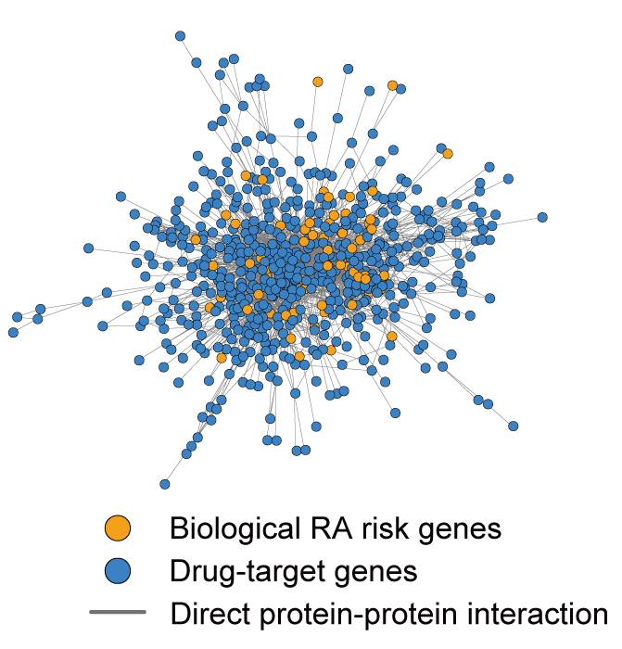
Enrichment between RA genetic networks and RA drugs
Okada et al (2013) Nature

Slide 18
Identify a series of alleles with range of effect sizes

Slide 19
Example of TYK2 and RA
Multiple alleles protect from RA
P=10⁻²⁵ in >30,000 case-control samples

Slide 20
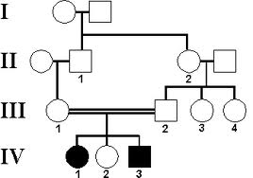
Complete knock-out leads to PID
Rare families with complete loss of TYK2
Indicates effect of maximum inhibition in ideal model organism (humans)
(Note: this pedigree is for illustrative purposes only)

Slide 21
Assess biological function to estimate “efficacy”

Slide 22
Functional studies show LOF
Studies in cell lines
Implicates catalytic function impaired
However, there are other functions of TYK2 which need further exploration

Slide 23
Assess pleiotropy as proxy for adverse events

Slide 24
PheWAS identifies RA and autoimmunity, but not other ADE’s
RA surpasses study-wide significance (dotted line)

Slide 25
PheWAS identifies RA and autoimmunity, but not other ADE’s
No obvious risk of infection

Slide 26
PheWAS suggests that tofacitinib ADEs not related to TYK2 inhibition

Slide 27
Putting it all together…
Multiple alleles protect from RA
Functional studies show LOF
P=10⁻²⁵ in >30,000 case-control samples
Complete KO leads to PID
No obvious “ADEs” in ~30K EMR patients

Slide 28
Efficacy
Toxicity
high
1
TYK2 -/- (protection)
2
Δ-TYK2 homozygotes (immunodeficiency)
Immune phenotype
TYK2 +/- (protection)
This provides evidence for the therapeutic window at the time of target validation.
3
low
normal
LOF
TYK2 function
Thus, (1) complete LOF leads to immunodeficiency;
(2) partial LOF (+/- heterozygotes) protects from RA; and
(3) -/- homozygotes have greatest protection from RA without obvious evidence of infection or other ADEs.

Slide 29
Finally, can genetics be used to select alternative indications for “repurposing”?

Slide 30
Same alleles associated with SLE – suggests other indications
P=10⁻¹⁸ in ~15,000 case-control samples

